Slide 1
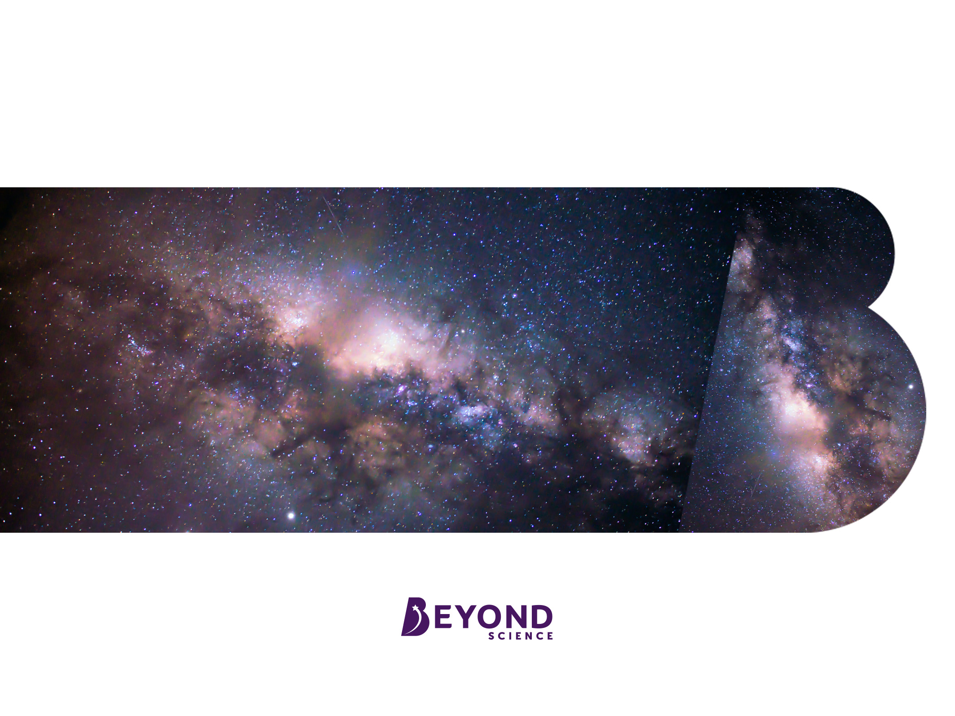
Life Cycle of a Star

Slide 2
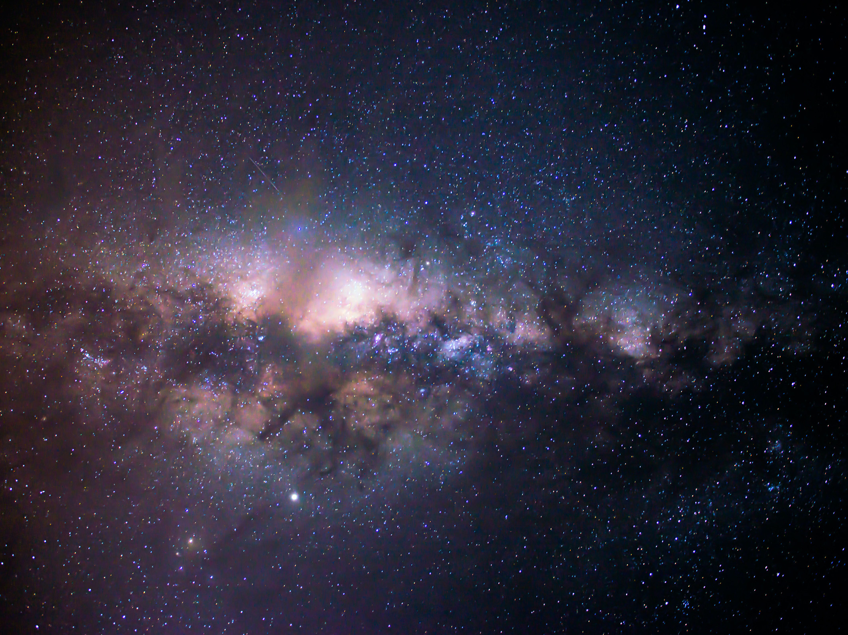
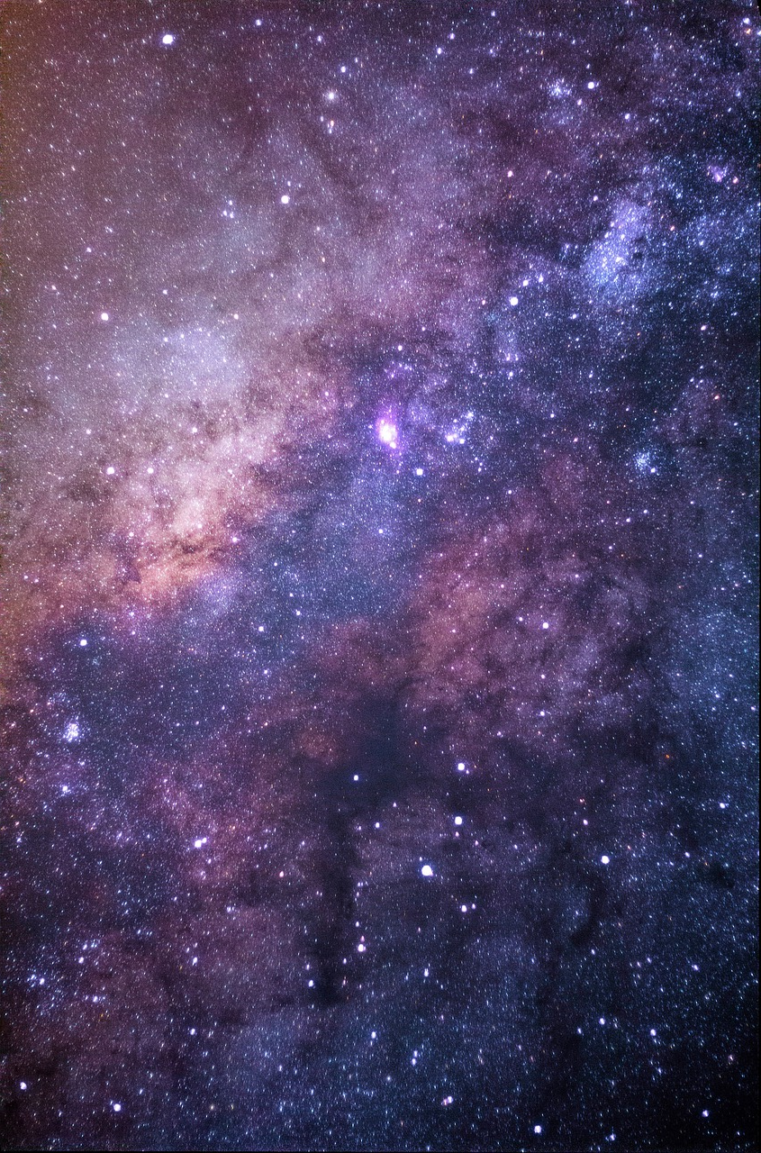
Stars
A star is a huge object in space that emits light and infrared radiation due to nuclear fusion in its core. Stars are made mostly of hydrogen and helium.
All naturally occurring elements are produced by fusion processes in stars.
This means almost every element that makes up your body was once part of a star. (‘Almost’ because it is possible that some of the hydrogen in your body came from the Big Bang instead.)

Slide 3
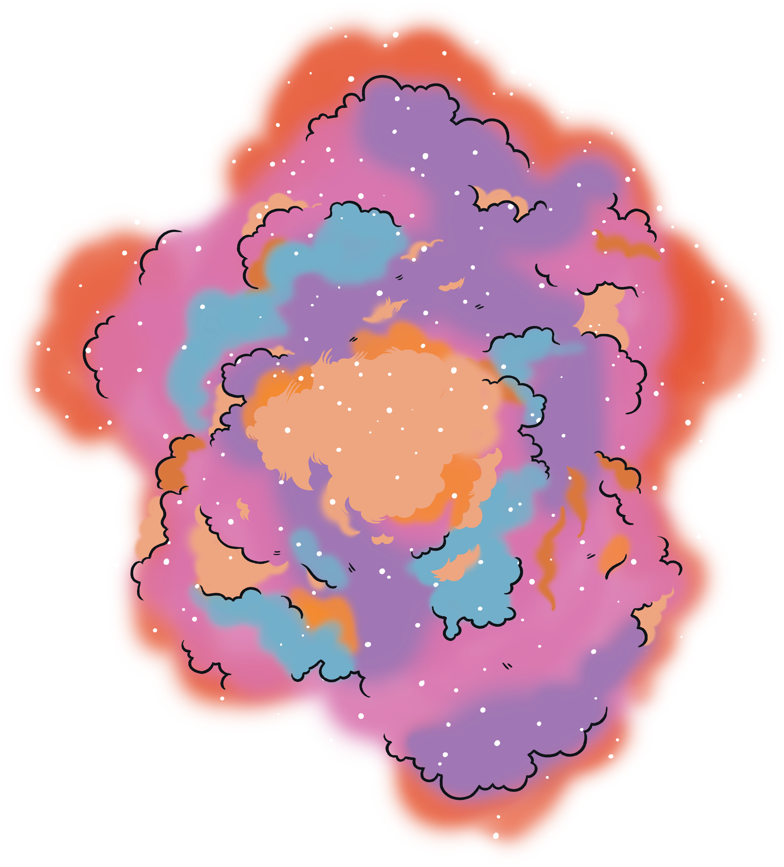
Nebula
All stars begin as a big cloud of dust and gas (mostly hydrogen) called a nebula.
Gravitational forces pull the particles in the nebula closer together, causing the cloud to get hotter and denser.
This results in an increase in pressure that means the particles collide more often.

Slide 4
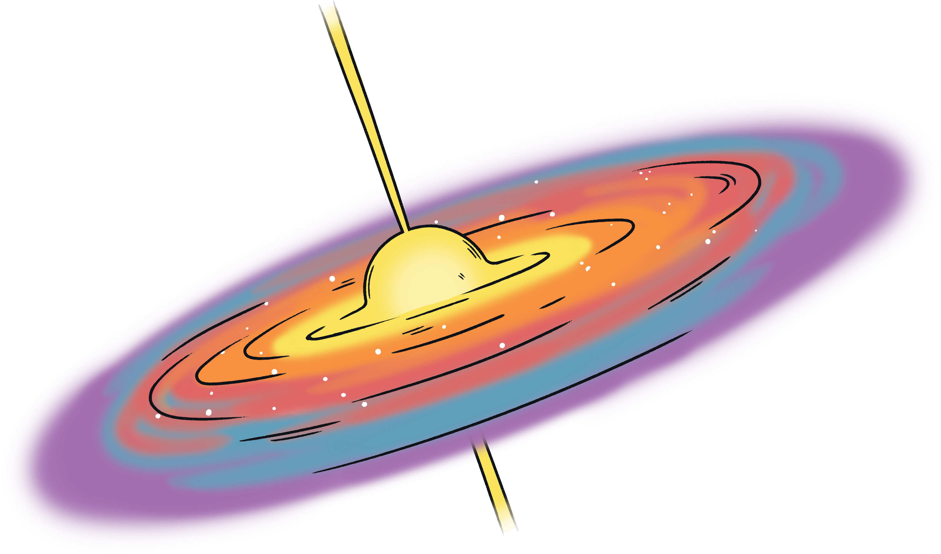
Protostar
The friction caused when the particles brush past each other increases the thermal energy store.
Light starts to be emitted.
This stage is called the protostar.

Slide 5

Main Sequence Star
Eventually, hydrogen nuclei gain enough energy that they start to fuse when they collide. This forms heavier, helium nuclei. This process is called nuclear fusion.
Since the nucleus of each atom is positively charged, the forces that cause the nuclei to repel each other must be overcome. The extreme temperature and pressure needed for fusion reactions only occurs naturally in a star.
The fusion increases the thermal energy store in the centre of the star which causes it to expand. The expansion is equal to the gravitational pull towards the centre and therefore, this part of the lifecycle is the most stable.

Slide 6
Main Sequence Star
The Sun in our Solar System is a main sequence star.
The larger the star, the hotter and brighter it will be and the faster it will move through the main sequence stage.
The next stage in the life cycle depends on the size of the star.

Slide 7
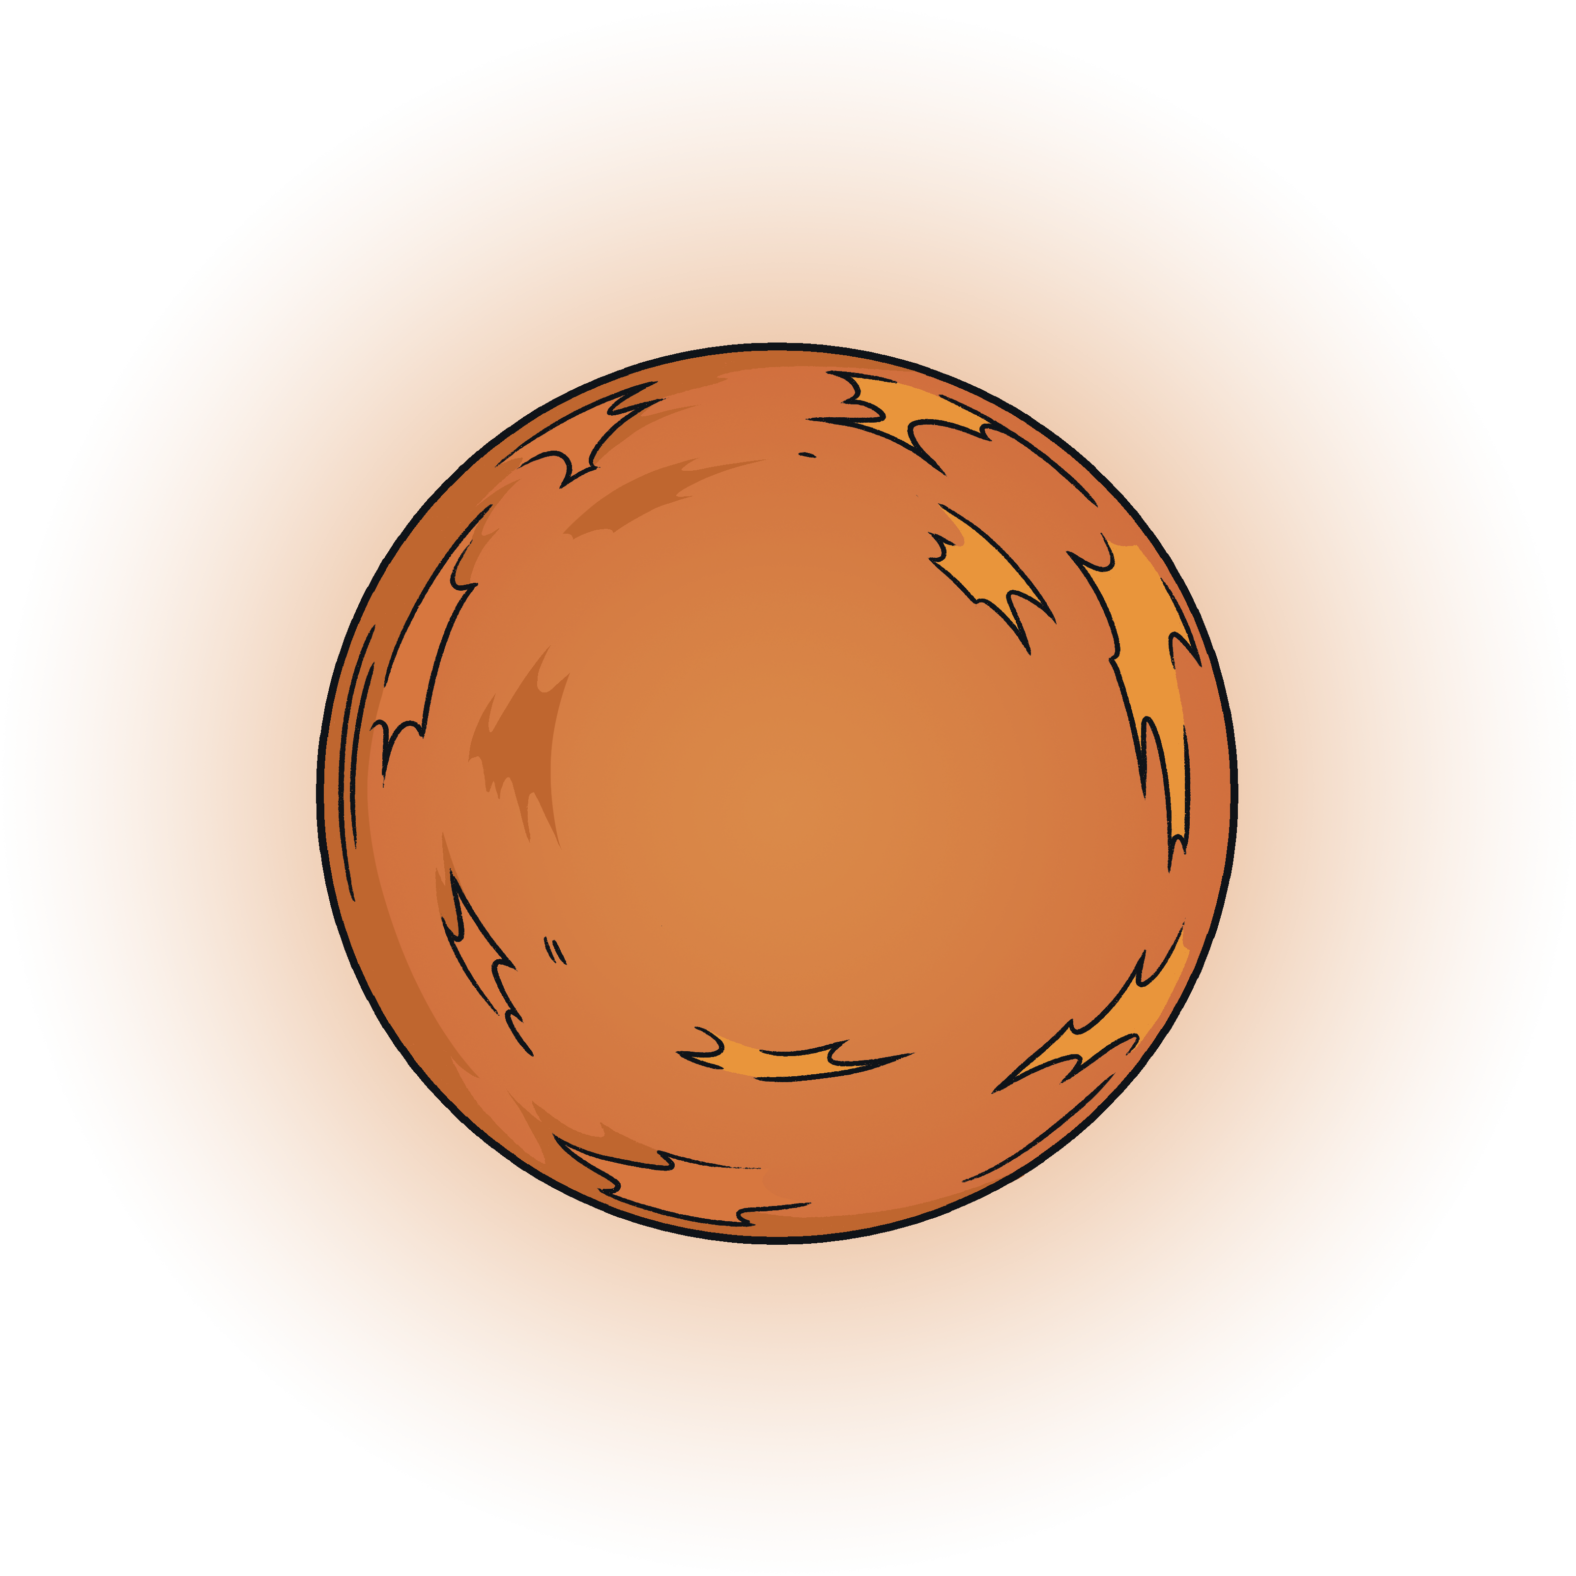
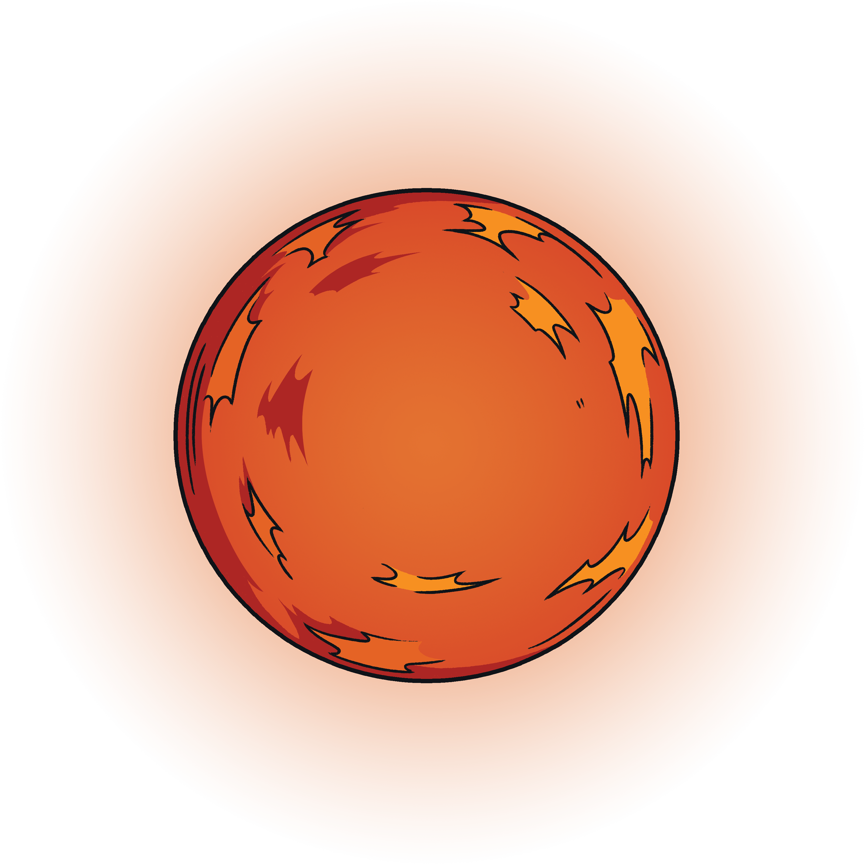
Main Sequence Star
Eventually, the main sequence star will use up all of the hydrogen in its core and the larger nuclei start to fuse together to make even heavier elements.
The fusion of larger nuclei causes an increase in the thermal energy store at the core of the star which makes the star rapidly expand.
Stars much bigger than the Sun will form a red supergiant.
Stars about the same size as the Sun will form a red giant.

Slide 8
Red Giant
As the main sequence star expands to form the red giant, it cools. The cooling is what causes it to appear more red.
The red giant is larger that the main sequence star, which makes it brighter.
Carbon and oxygen can be made by fusion in the red giant stage.
The Sun in our Solar System will expand into a red giant in 5 million years.
main sequence star
red giant

Slide 9

White Dwarf
At the end of the red giant stage, fusion stops and the gravitational forces acting inwards are stronger than the expansive forces acting outwards.
This causes the star to collapse inwards.
The outer layers of the star are expelled and the leftover core is known as a white dwarf.
White dwarf stars are very bright and very hot because all of their energy is condensed into a small area.

Slide 10

Black Dwarf
Over time, energy is emitted from the white dwarf star to the surroundings.
The star gets dimmer and dimmer until it turns into a brown, and then a black dwarf star.

Slide 11
A Star the Size of the Sun
nebula
protostar
main sequence
star
red giant
white dwarf
black dwarf

Slide 12
Red Supergiant
Main sequence stars which are much bigger than the Sun will form a red supergiant when they expand.
Elements up to the size of iron can fuse in a red supergiant.
red giant
red supergiant

Slide 13
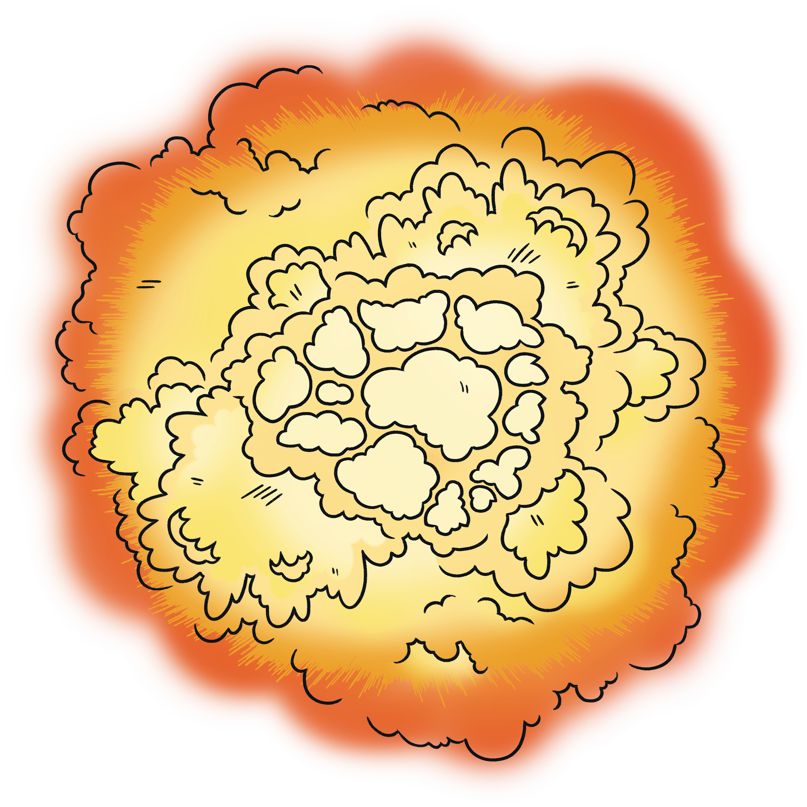
Supernova
The fusion of nuclei as large as iron in the red supergiant causes the core to get denser.
When it runs out of fuel, the core is so heavy that its gravitational force pulls the outer layers of the star in towards the centre.
The shockwaves resulting from this collapse cause the star to explode in a supernova.

Slide 14

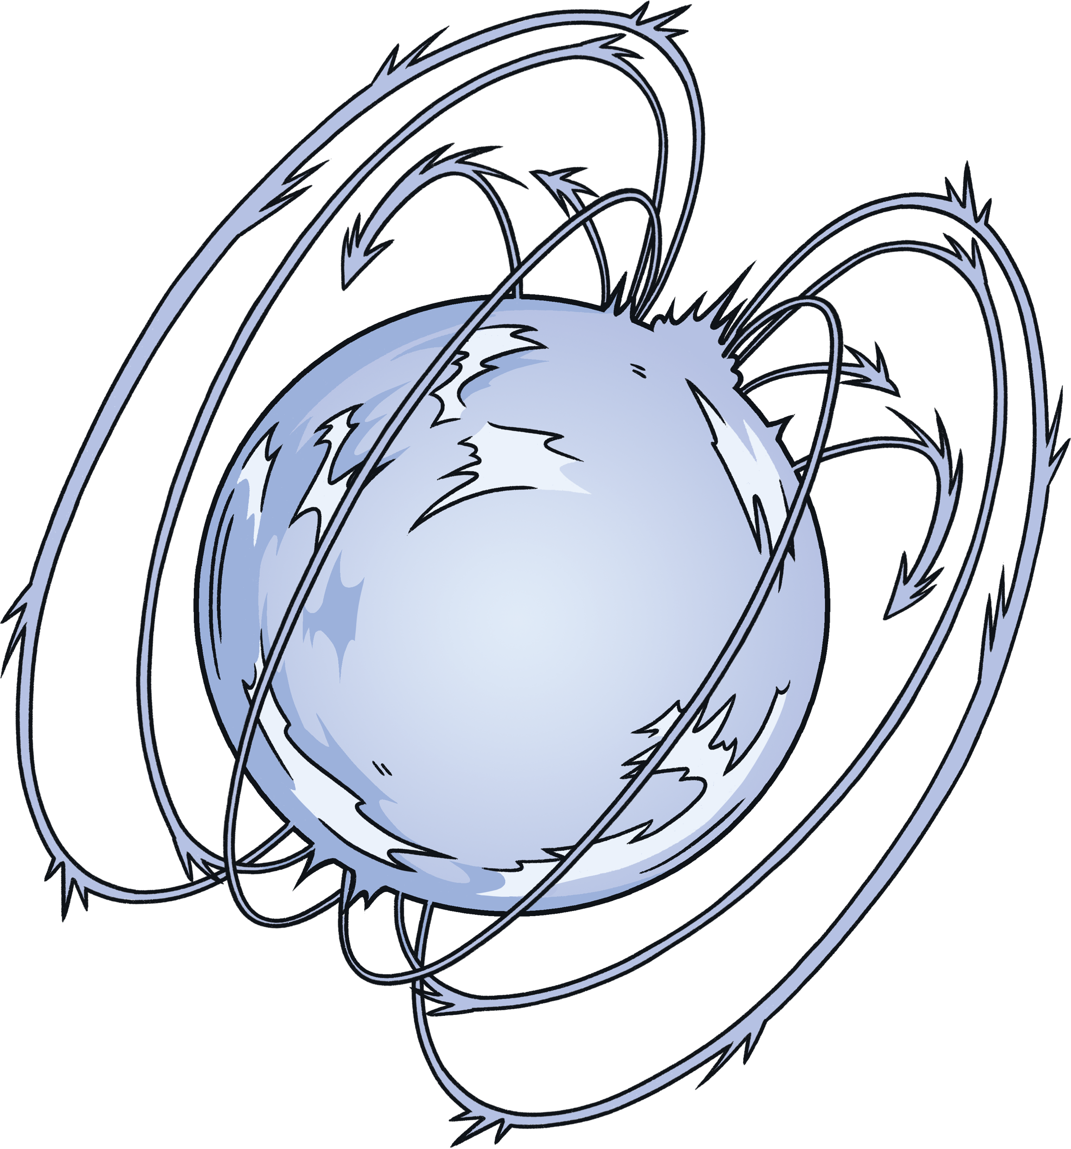
Supernova
The size of the supernova will determine the next stage of the life cycle.
Most supernovae form neutron stars.
The largest supernovae form black holes.

Slide 15
Neutron Star
At the centre of a supernova, the particles form an incredibly dense core.
This causes the supernova to collapse into a neutron star.
Neutron stars are the smallest and densest known star.
Fusion does not occur at this stage.

Slide 16
Black Hole
The largest supernovae collapse to form black holes.
The name might make you think of an empty space, but actually there is a huge amount of matter packed into a tiny area.
Gravity in a black hole is so strong that not even light can escape.

Slide 17
A Star More Massive Than the Sun
neutron star
nebula
protostar
main sequence
star
red supergiant
black hole

Slide 18
The Life Cycle of a Star
about the same size as the sun
red giant
white dwarf
black dwarf
main sequence
star
nebula
protostar
neutron star
more massive than the sun
red supergiant
supernova
black hole

Slide 19
